Slide 1


CSCE 5640 Operating System Design Introduction
Dr. Amar Maharjan
Computer Science and Engineering
University of North Texas
Slides (with some modifications) from:
Operating System Concepts – Silberschatz, Galvin and Gagne © 2018

Slide 2
What is an Operating System?
A program that acts as an intermediary between a user of a computer and the computer hardware
Operating system goals:
Execute user programs and make solving user problems easier.
Make the computer system convenient to use.
Use the computer hardware in an efficient manner.
Allocate different resources (CPU, memory, I/O devices, storage) to programs.
Notes:
Operating System is a special program that contains many components.
Hardware does the computational work, user utilizes software to make hardware do the work.

Slide 3
Computer System Structure
Computer system can be divided into four components:
Hardware – provides basic computing resources
CPU, memory, I/O devices
Operating system
Controls and coordinates use of hardware among various applications and users
Application programs – define the ways in which the system resources are used to solve the computing problems of the users
Word processors, compilers, web browsers, database systems, video games
Users
People, machines, other computers

Slide 4
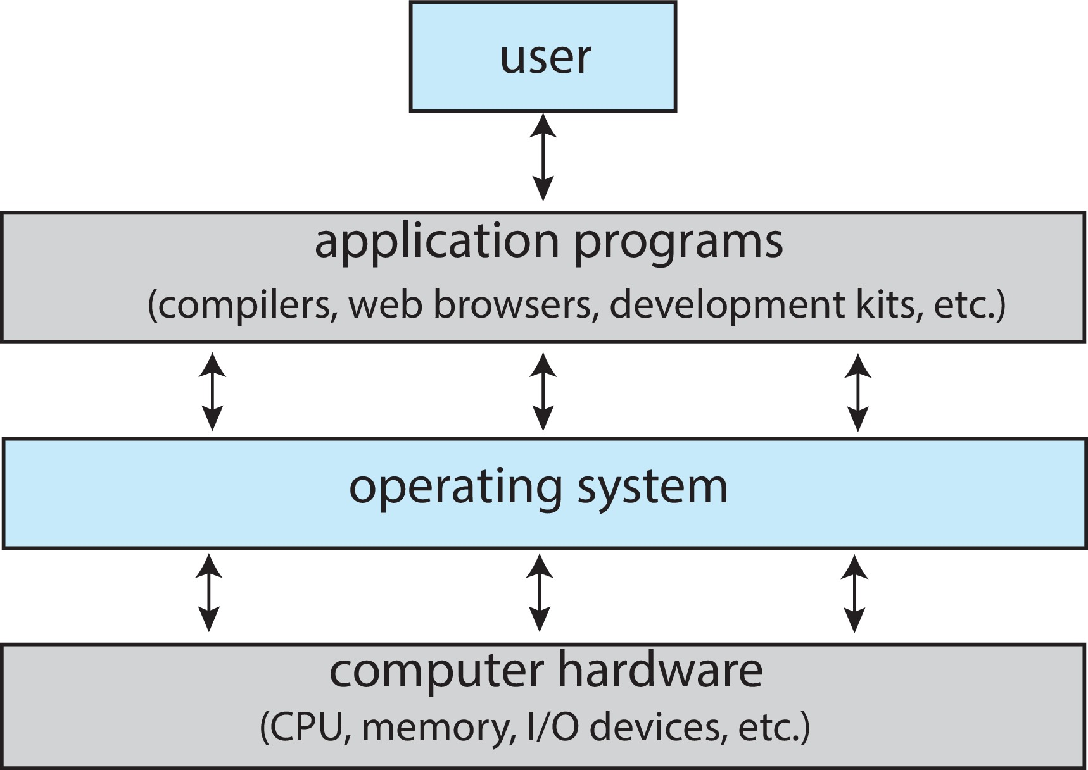
Abstract View of Components of Computer

Slide 5
What Operating Systems Do
Depends on the point of view: user and system
Users want convenience, ease of use and good performance
Don’t care about resource utilization
Mobile devices like smartphones and tables are resource poor, optimized for usability and battery life
Mobile user interfaces such as touch screens, voice recognition (eg: Apple’s Siri).
Some computers have little or no user interface, such as embedded computers in devices and automobiles
Run primarily without user intervention
But shared computer such as mainframe or minicomputer must keep all users happy
Operating system is a resource allocator and control program making efficient use of HW and managing execution of user programs
Notes:
The main job of OS is to make it easy to use from the user's perspective [Ex: Double tab on the screen to do something]
It acts as. Resource allocator from a systems perspective.

Slide 6
Defining Operating Systems
Term OS covers many roles
Because of myriad designs and uses of OSes
Computers are present within toasters, ships, spacecraft, game machines, TVs and industrial control systems
Born with fixed-purpose systems for military uses, such as code breaking and trajectory plotting, and government uses, such as census calculation
Evolved into more general purpose and needed resource management and program control.

Slide 7
Operating System Definition
No universally accepted definition
“Everything a vendor ships when you order an operating system” is a good approximation
But varies wildly
“The one program running at all times on the computer” is the kernel, part of the operating system
Everything else is either
A system program (ships with the operating system, but not part of the kernel), or
An application program, all programs not associated with the operating system
Today’s OSes for general purpose and mobile computing also include middleware
a set of software frameworks that provide additional services to application developers such as databases, multimedia, graphics
Notes:
The OS can also be defined as the special type of Kernel along with other programs

Slide 8
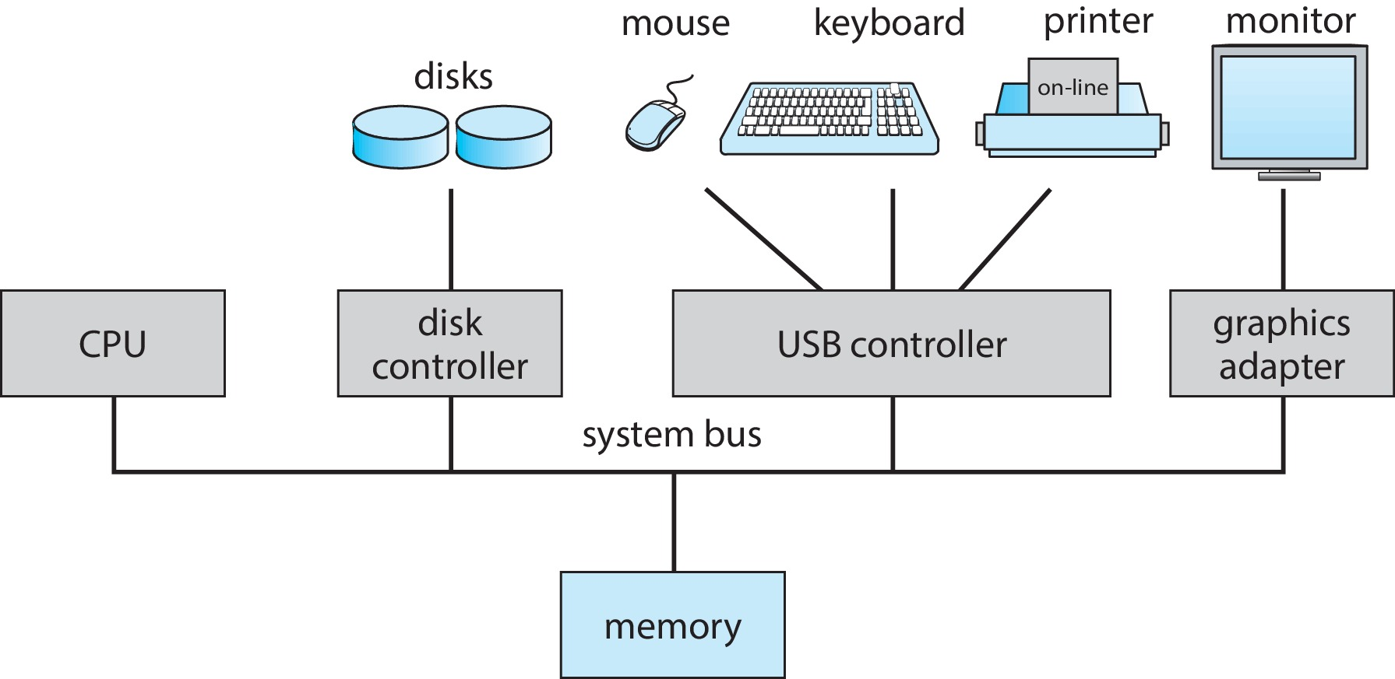
Computer System Organization
Computer-system operation.
One or more CPUs, device controllers connect through common bus providing access to shared memory.
Concurrent execution of CPUs and devices competing for memory cycles.
Notes:
Every hardware is controlled by a device driver which communicates with the OS.

Slide 9
Computer-System Operation
I/O devices and the CPU can execute concurrently
Each device controller is in charge of a particular device type
Each device controller has a local buffer
Typically, operating systems have a device driver for each device controller.
Device controller informs CPU that it has finished its operation by causing an interrupt.
Notes:
CPU moves data from/to main memory to/from local buffers
I/O is from the device to the local buffer of the controller
The CPU is executing some instructions and something important happens (interrupt), now the CPU should first focus on the interrupt task and then come back to its previous instruction.
An interrupt is used to inform something important has happened.

Slide 10
Common Functions of Interrupts
Interrupt transfers control to the interrupt service routine generally, through the interrupt vector, which contains the addresses of all the service routines
Interrupt vector is indexed by a unique number, given with the interrupt request, to provide the address of the interrupt service routine for the interrupting device.
Interrupt architecture must save the address of the interrupted instruction
A trap or exception is a software-generated interrupt caused either by an error or a user request
An operating system is interrupt driven.
Notes:
Interrupts are stored in an array.
Null exceptions or divisible by 0 are interruptions.

Slide 11
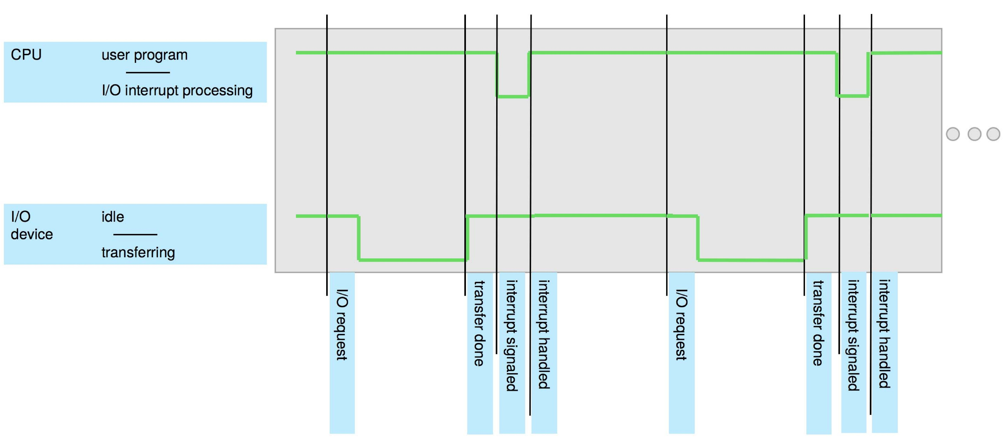
Interrupt Timeline

Slide 12
Interrupt Handling
The operating system preserves the state of the CPU by storing the registers and the program counter
Determines which type of interrupt has occurred:
Separate segments of code determine what action should be taken for each type of interrupt
Notes:
Once the interrupt is handled it should come back to the previous task, to preserve the state registers are used to store.

Slide 13
Interrupt-drive I/O Cycle
Notes:
I/O controller output (4) can be a success or failure, it must inform the CPU regarding that.
From above figure
2: I/O request
3: I/O executing
4: Interrupt

Slide 14
Storage Structure
The CPU can load instructions only from memory.
Main memory – Random Access Memory (RAM)
Typically, volatile
Commonly implemented in a semiconductor technology - Dynamic Random-access Memory (DRAM)
Secondary storage – extension of main memory that provides large nonvolatile storage capacity
Hold large quantities of data permanently.
Much slower than main memory.
Notes:
All the instructions must be loaded in RAM.
In RAM, fetching the data from the start, middle, or end takes the same time, but that is not the case in Hard disk.

Slide 15
Storage Hierarchy
Storage systems organized in hierarchy
Speed
Cost
Volatility
Trade-off between size and speed
Small and faster memory close to the CPU
In general
Volatile storage will be referred to simply as memory.
Nonvolatile storage (NVS) retains its contents even when power is lost
Mechanical: HDDs, optical disks, magnetic tapes
Electrical: flash memory, Solid State Drives (SSD). Referred as NVM.
Notes:
Caching – copying information into faster storage system; main memory can be viewed as a cache for secondary storage
Device Driver for each device controller to manage I/O; Provides uniform interface between controller and kernel
Cache is default in CPU – less size

Slide 16
Storage Structure (Cont.)
Common secondary-storage types:
Hard Disk Drives (HDD) – rigid metal or glass platters covered with magnetic recording material
Disk surface is logically divided into tracks, which are subdivided into sectors
The disk controller determines the logical interaction between the device and the computer
Non-volatile memory (NVM) devices– faster than hard disks, nonvolatile
Becoming more popular as capacity and performance increases, price drops

Slide 17
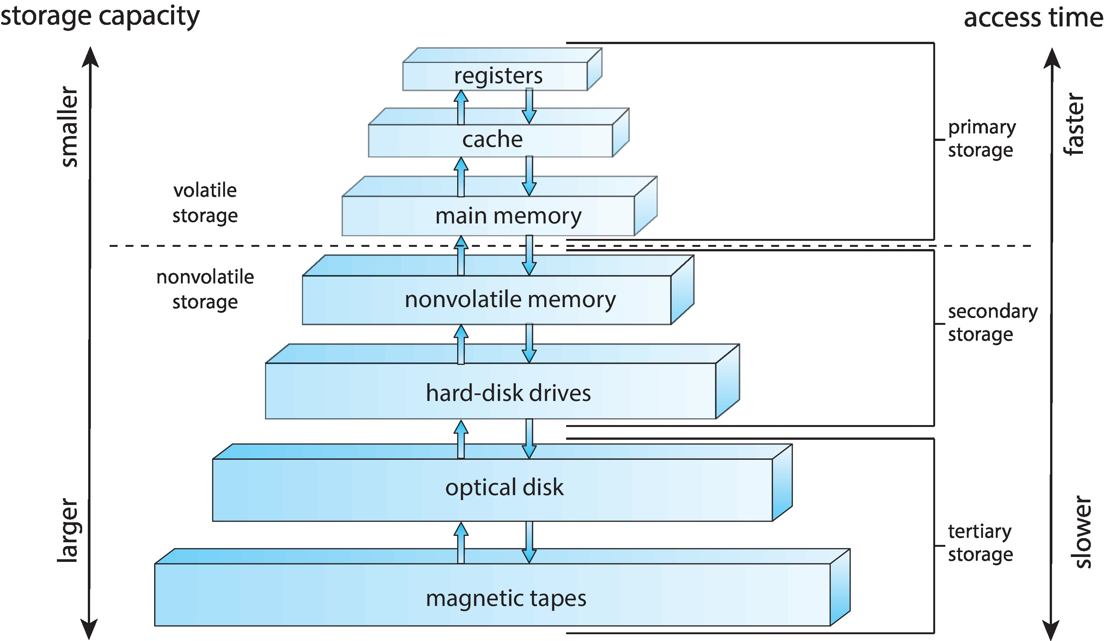
Storage-Device Hierarchy
Notes:
Registers and cache are found in CPU’s (within CPU)

Slide 18
I/O Structure
Interrupt-driven I/O
Good for moving small amounts of data.
But can produce high overhead when used for bulk data movement such as NVS I/O.
Direct Memory Access (DMA)
The device controller transfers an entire block of data directly to or from the device and main memory, no intervention by the CPU.
Only one interrupt is generated per block, rather than the one interrupt per byte
The CPU is available to accomplish other work while the device controller is performing the operations.
Notes:
Interrupt-driven I/O: Whenever there is data, we can send it.

Slide 19
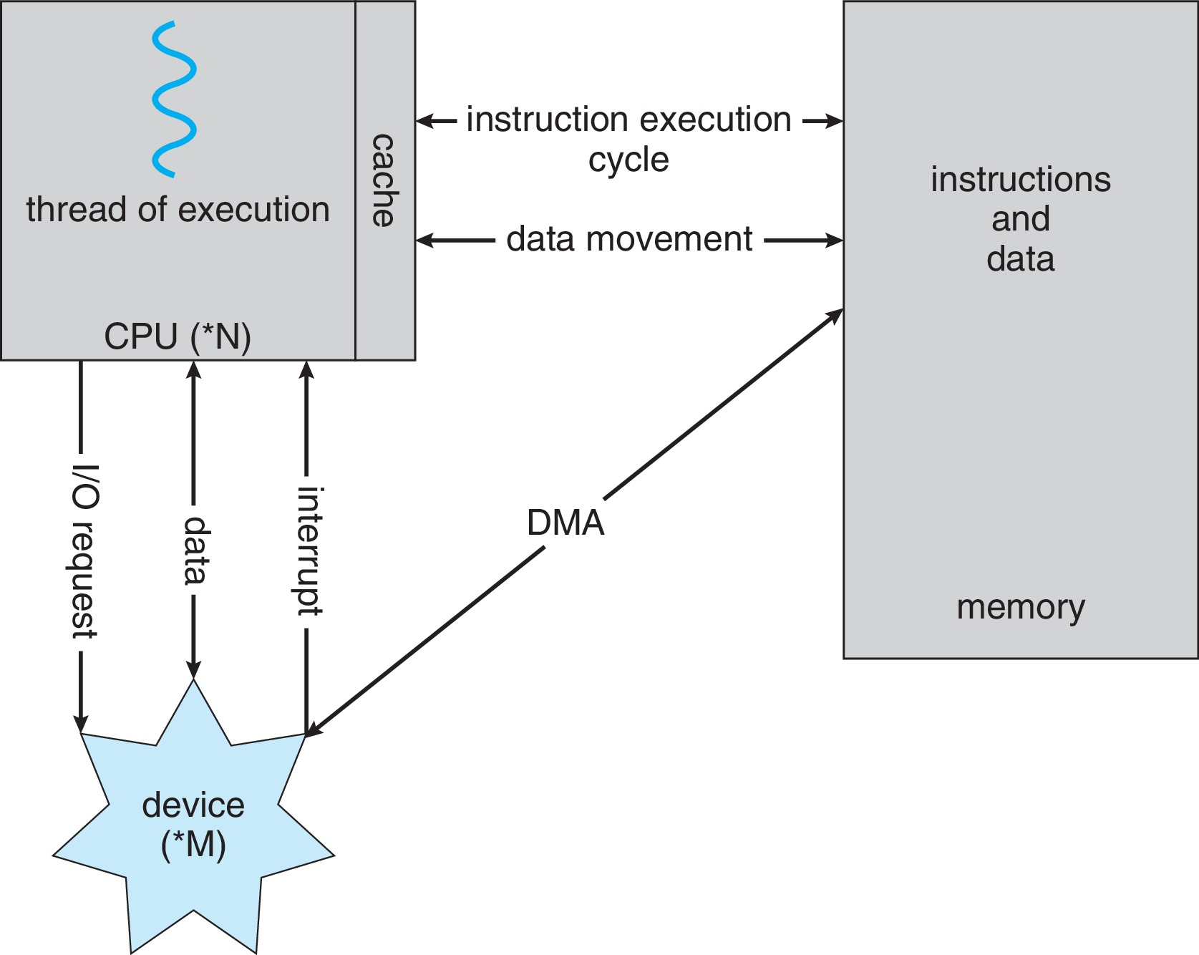
How a Modern Computer Works
Notes:
The thread will execute instructions line by line, it’s fundamental.

Slide 20
Computer-System Architecture
Categorize according to the number of general-purpose processors used.
Most systems use a single general-purpose processor – single processing core.
Most systems have special-purpose processors as well
Multiprocessors systems growing in use and importance
Two (or more) processors, each with a single-core CPU.
The processors share the computer bus, and sometimes the clock, memory and peripheral devices.
Primary advantage - throughput
Most common multiprocessor system
Symmetric Multiprocessing (SMP) – each processor performs all tasks
Notes:
The core is the component that executes instructions and registers for storing data locally
Asymmetric Multiprocessing – each processor is assigned a specie task.
Categorized based on the number of CPUs or processors.
Multiprocessor – Multiple CPUs and each CPU has 1 core. Some may have 1 CPU with multiple cores.
Core means executing memory
Each core has its own Registers and Cache.
Throughput – How many tasks/processes are completed in unit time (1min or 1hr).
Asymmetric – 1 CPU acts as master and other are slaves.

Slide 21
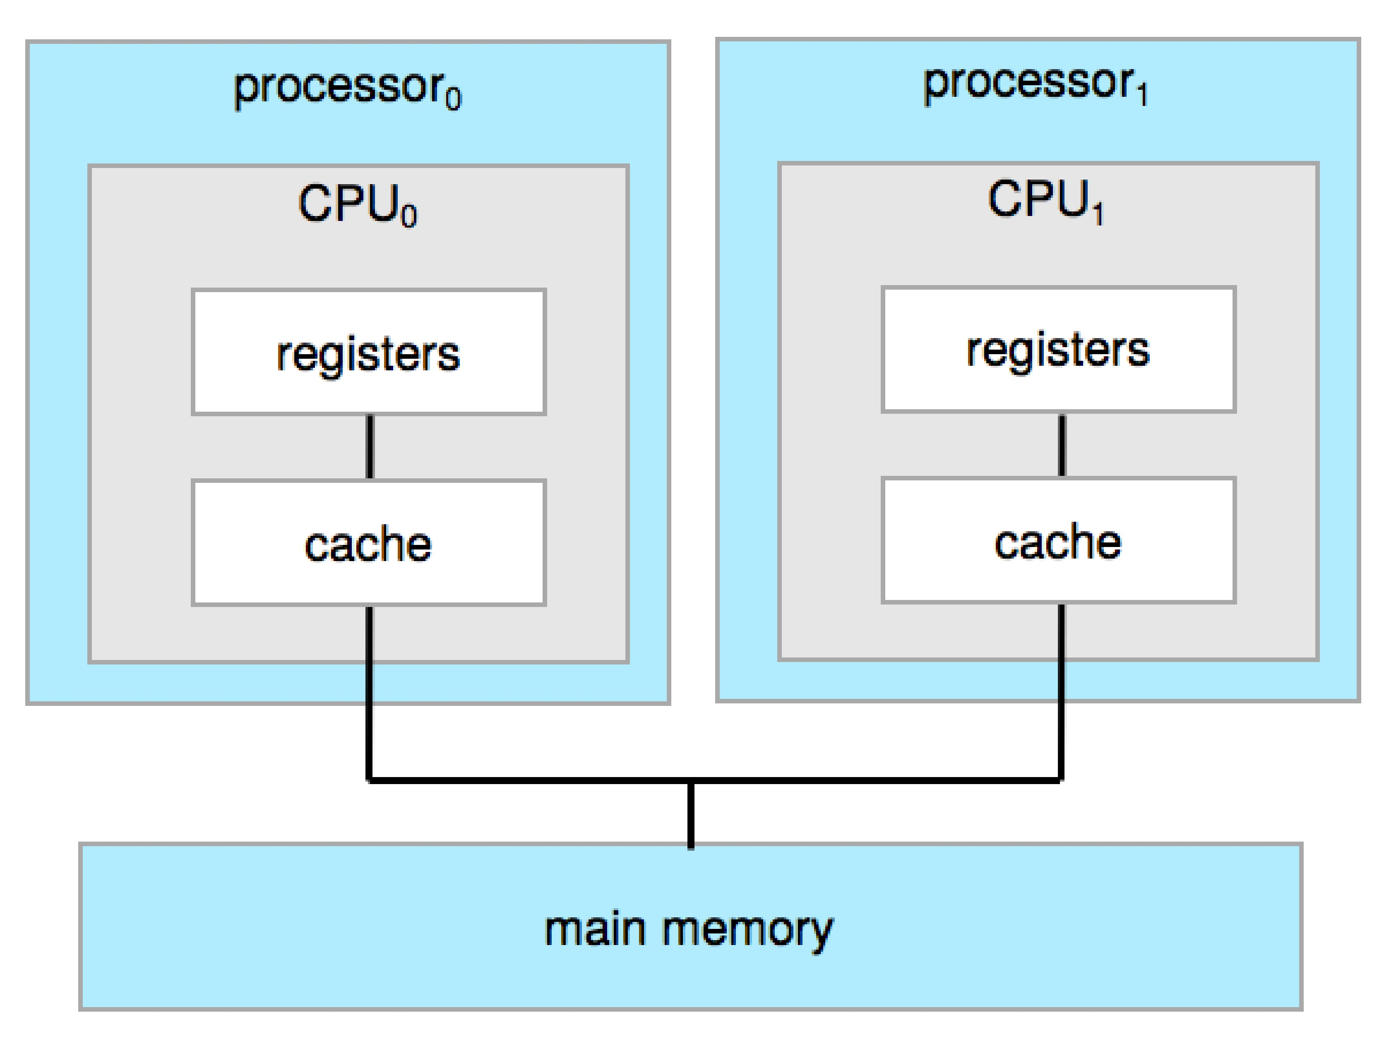
Symmetric Multiprocessing Architecture
Notes:
They can execute different programs parallelly.

Slide 22
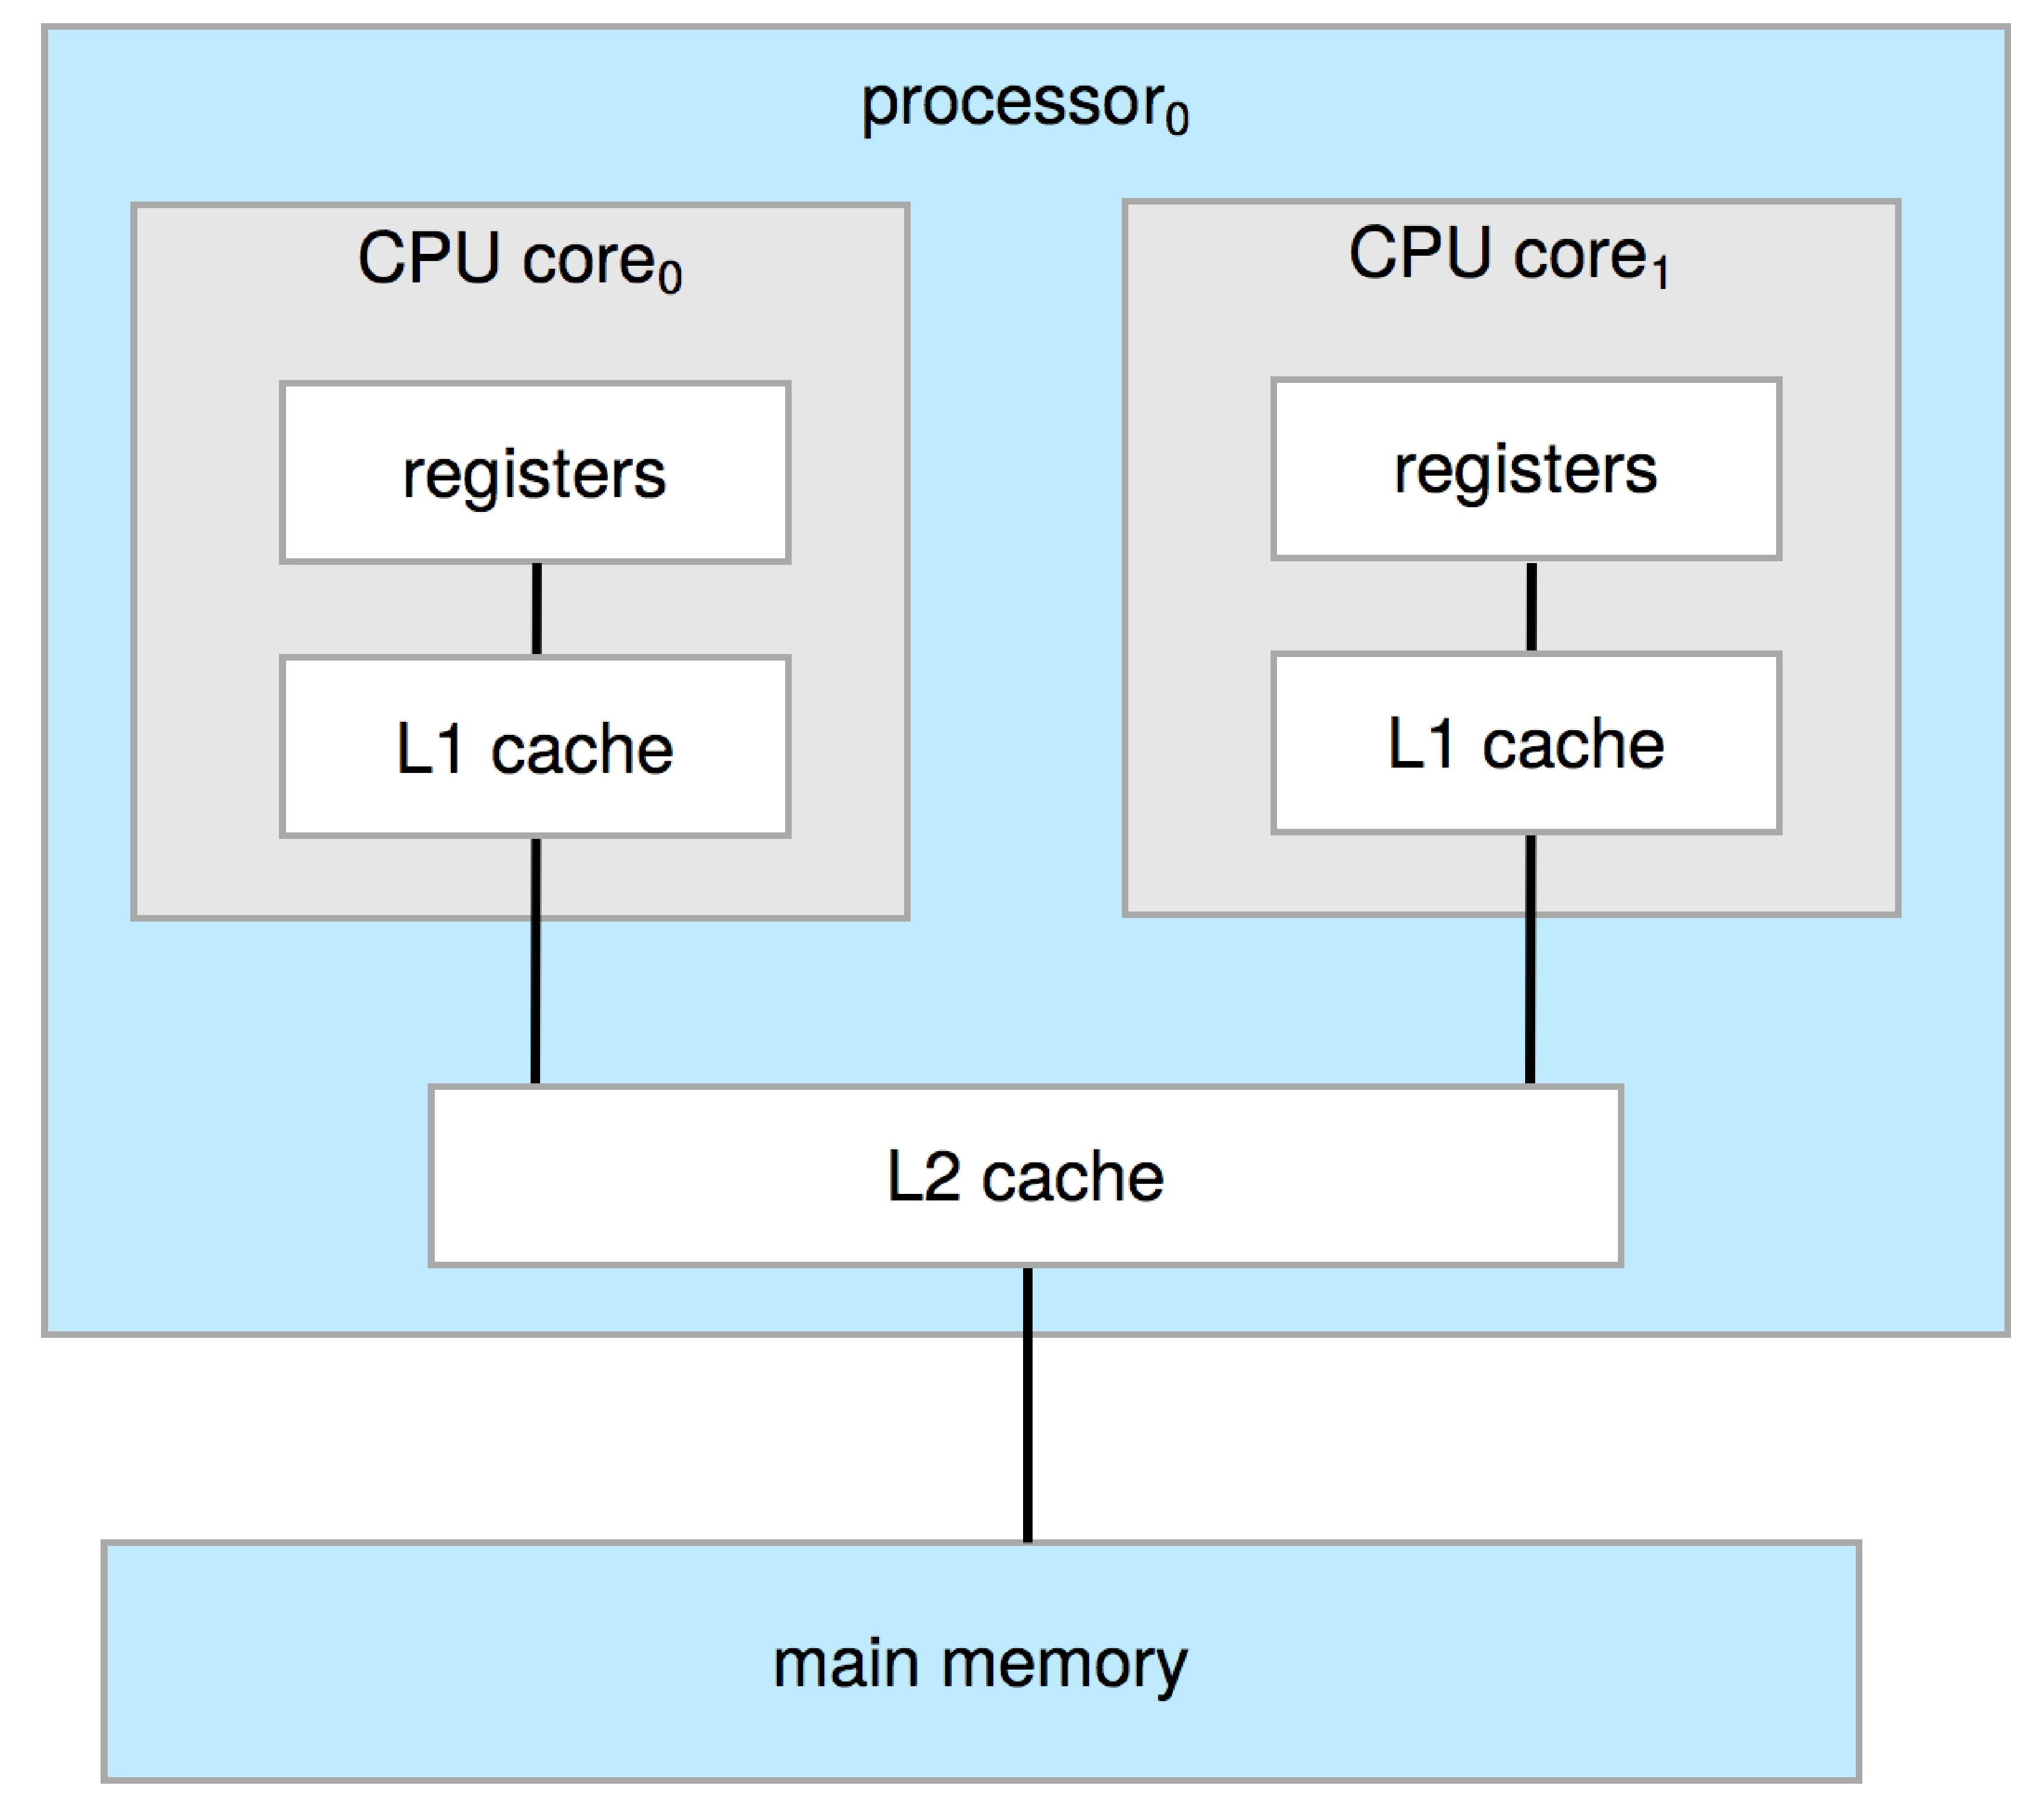
Multicore systems
Multiple computing core reside on a single chip.
More efficient than multiple chips with single cores
On-chip communication is faster than between-chip communication.
Uses significantly less power than multiple single-core chips.
Important in mobile, laptop devices
Dual-Core Design
Notes:
Chip means CPU
Core – the fundamental unit of execution.
L2 cache is shared.
This is more efficient. (1 CPU with many cores) when compared to many CPUs with each 1 core because of communication between cores.
This may not perform well in cloud or something like that, so we have next one.

Slide 23
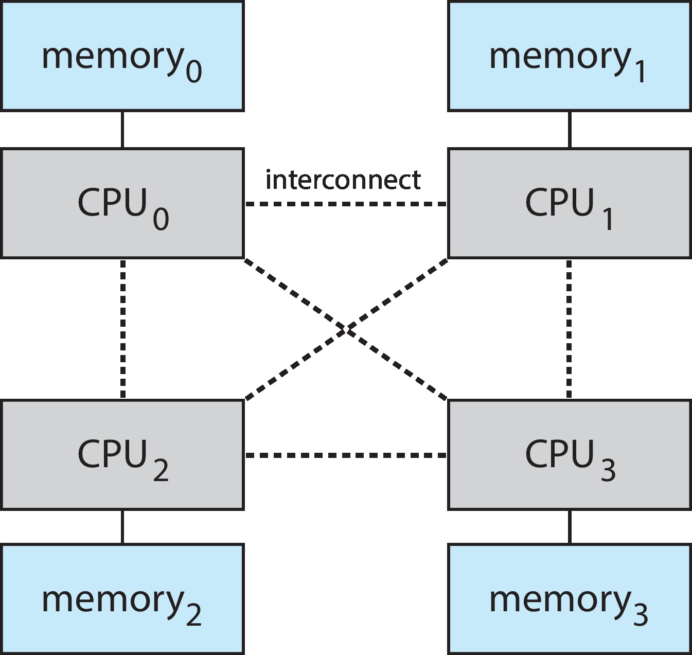
Non-Uniform Memory Access System
Adding too many CPUs
Contention for the system bus becomes a bottleneck and performance begins to degrade.
Alternative approach - NUMA
Each CPU (or group of CPUs) with its own local memory – accessed via a small, fast local bus.
The CPUs are connected by a shared system interconnect.
Any drawback?
Notes:
Sharing data between CPUs may take time and is expensive.
Attach the local memory of each CPU.
Memory 0 can also be accessed by CPU 1 or other, most of the time it is used by CPU 0.

Slide 24
Clustered Systems
Like multiprocessor systems, but multiple systems working together
Usually sharing storage via a storage-area network (SAN)
Provides a high-availability service which survives failures
Asymmetric clustering has one machine in hot-standby mode
Symmetric clustering has multiple nodes running applications, monitoring each other
Some clusters are for high-performance computing (HPC)
Applications must be written to use parallelization
Notes:
Multiple systems working together from far.
Hot standby mode – One machine is not working, so the other machine does its work till it is up and running.

Slide 25
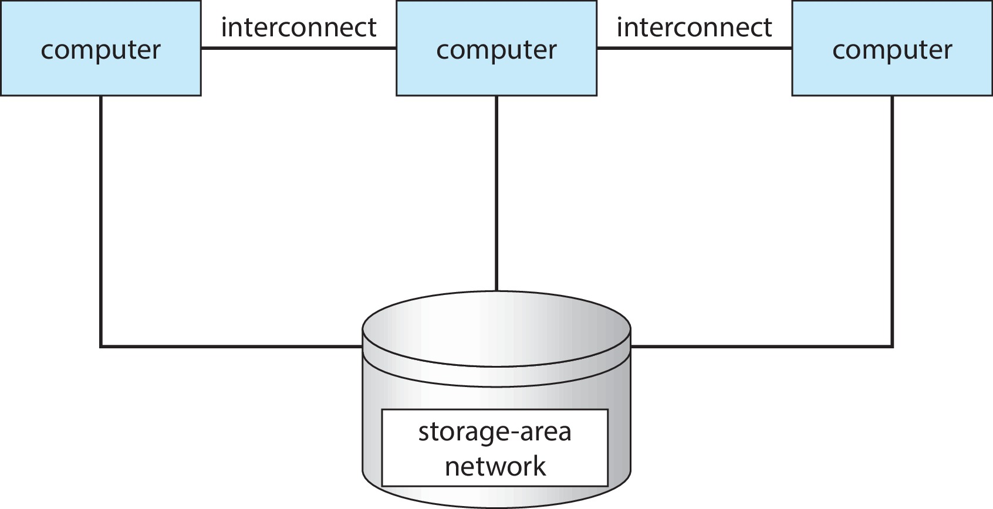
Clustered Systems
General structure of a clustered system
Notes:
Computers can be far from each other.

Slide 26
Operating-System Operations
An OS provides the environment within which programs are executed.
Bootstrap program – simple code to initialize the system, load the kernel
Loads Kernel into memory.
Typically stored in firmware.
Starts system daemons (services provided outside of the kernel)
Kernel interrupt driven (hardware and software)
Hardware interrupt by one of the devices
Software interrupt (exception or trap):
Software error (e.g., division by zero or invalid memory access)
Request for operating system service – system call
Other process problems include infinite loop, processes modifying each other or the operating system
Notes:
When we load the OS in the memory, it will not be loaded automatically, we need the bootstrap program to load the OS to memory.
Bootstrap program is written in ROM.
The size of the bootstrap program is small because its job is only to load the OS.
System daemons do not have any UI but they will run in the background.
Each system has its own system calls.
To create a new thread we cannot do that directly we need to ask the OS to do that using system call.

Slide 27
Multiprogramming (Batch system)
One of the important aspects of OS
Run multiple programs and use full resource utilization.
Single program cannot always keep CPU and I/O devices busy.
Multiprogramming organizes jobs/programs (code and data), so CPU always has one to execute.
A subset of total jobs in system is kept in memory.
One job selected and run via job scheduling.
When job must wait (for example, I/O), OS switches to another job.
Notes:
Multiprogramming – Running multiple programs parallelly to utilize the resources efficiently.
Job scheduling – Which job to do next?

Slide 28
Multitasking (Timesharing)
A logical extension of Batch systems
The CPU switches jobs so frequently that users can interact with each job while it is running, creating interactive computing
Provides fast response time.
Each user has at least one program executing in memory  process
If several jobs ready to run at the same time  CPU scheduling
If processes don’t fit in memory, swapping moves them in and out to run
Virtual memory allows execution of processes not completely in memory
Enables users to run programs that are larger than actual physical memory.
Notes:
Execute the task for a small amount of time and switch to another job.
CPU scheduling – Decides which job to pick next from a pool of task using different algorithms.

Slide 29
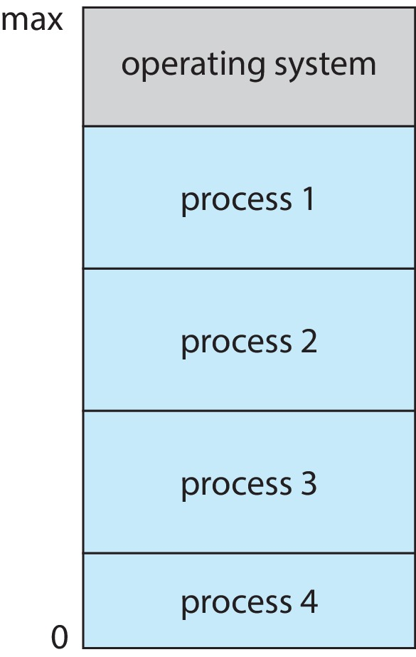
Memory Layout for Multiprogrammed System
Notes:
If we have process 5 also then we need to kick out low-priority tasks.
Or we can use paging, which means loading only some parts of the process.
There is no correct answer, we can use some algorithm.

Slide 30
Dual-mode Operation
OS must ensure that an incorrect (or malicious) program cannot cause other programs to execute incorrectly.
Must distinguish between the execution of OS code and user-defined code.
Dual-mode operation allows OS to protect itself and other system components
User mode and kernel mode (supervisor mode, system mode, or privileged mode).
Mode bit provided by hardware.
Provides ability to distinguish when system is running user code or kernel code.
When a user is running  mode bit (1) is “user”
When kernel code is executing  mode bit (0) is “kernel”
How do we guarantee that user does not explicitly set the mode bit to “kernel”?
System call changes mode to kernel, return from call resets it to user.
Some instructions designated as privileged, only executable in kernel mode.
Notes:
The instruction to switch to kernel mode is an example of a privileged instruction.
Some other examples include I/O control, timer management, and interrupt management.
OS should know who is executing the process – OS or the user. Both cannot be executed together.
To know who is executing we can maintain a bit.

Slide 31
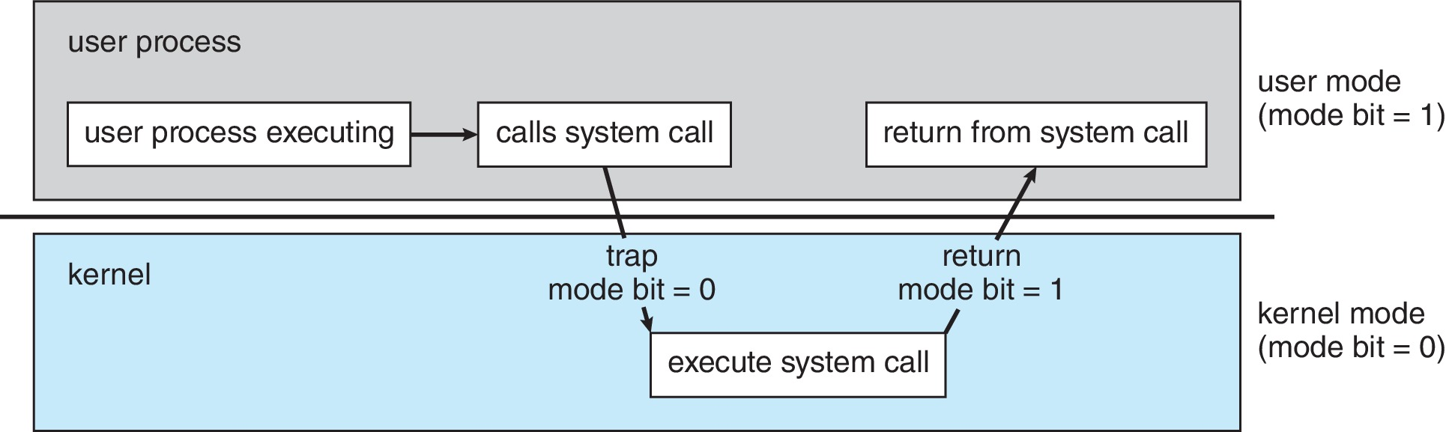
Transition from User to Kernel Mode
Notes:
It could be possible that the system call can be denied by the OS.

Slide 32
Timer
Timer to prevent infinite loop (or process hogging resources)
Timer is set to interrupt the computer after some time period
Keep a counter that is decremented by the physical clock
Operating system set the counter (privileged instruction)
When counter zero generate an interrupt
Set up before scheduling process to regain control or terminate program that exceeds allotted time

Slide 33
Resource Management
An OS is a resource manager.
OS manages
The system’s CPU
Memory space
File-store space
I/O devices
Process Management
Memory Management
File-System Management
Mass-Storage Management
I/O System Management
Notes:
OS also manages security-related stuff as well.

Slide 34
Process Management
A process is a program in execution. It is a unit of work within the system.
Program is a passive entity; process is an active entity.
Process needs resources to accomplish its task
CPU, memory, I/O, files
Initialization data
Process termination requires reclaim of any reusable resources
Single-threaded process has one program counter specifying location of next instruction to execute
Process executes instructions sequentially, one at a time, until completion
Multi-threaded process has one program counter per thread
Typically, system has many processes, some user, some operating system running concurrently on one or more CPUs
Concurrency by multiplexing the CPUs among the processes / threads
Notes:
To run the program we need to load it in memory/RAM, process management will load.
Program counter – Pointer which contains the address of the next process to be executed.

Slide 35
Process Management Activities
The operating system is responsible for the following activities in connection with process management:
Creating and deleting both user and system processes
Suspending and resuming processes
Providing mechanisms for process synchronization
Providing mechanisms for process communication
Providing mechanisms for deadlock handling
Notes:
Synchronization: Multiple processes asking request of the same resource
Open multiple processes – how they can communicate with each other

Slide 36
Memory Management
To execute a program all (or part) of the instructions must be in memory
All (or part) of the data that is needed by the program must be in memory
Memory management determines what is in memory and when
Optimizing CPU utilization and computer response to its users, computers must keep several programs in memory
Memory management activities
Keeping track of which parts of memory are currently being used and by whom
Deciding which processes (or parts thereof) and data to move into and out of memory
Allocating and deallocating memory space as needed
Notes:
All memory-related tasks are done by memory management.
To execute the program it should be loaded in memory.

Slide 37
File-system Management
OS provides uniform, logical view of information storage
Abstracts physical properties to logical storage unit - file
Each medium is controlled by device (i.e., disk drive, tape drive)
Varying properties include access speed, capacity, data-transfer rate, access method (sequential or random)
File-System management
Files usually organized into directories
Access control on most systems to determine who can access what
OS activities include
Creating and deleting files and directories
Primitives to manipulate files and directories
Mapping files onto secondary storage
Backup files onto stable (non-volatile) storage media
Notes:
Securing files and protecting them from other users is also handled.
NTFS file system is used in Windows OS.
To access the files quickly we need to know where the file is stored, this data is stored in the file system.

Slide 38
Mass-Storage Management
Usually, disks used to store data that does not fit in main memory or data that must be kept for a “long” period of time
Proper management is of central importance
Entire speed of computer operation hinges on disk subsystem and its algorithms
OS activities
Mounting and unmounting
Free-space management
Storage allocation
Disk scheduling
Partitioning
Protection
Notes:
Disk sub-system is not specifically the disk, and it can also be secondary memory.

Slide 39
Caching
Important principle, performed at many levels in a computer (in hardware, operating system, software)
Information in use copied from slower to faster storage temporarily
Faster storage (cache) checked first to determine if information is there
If it is, information used directly from the cache (fast)
If not, data copied to cache and used there
Cache smaller than storage being cached
Cache management important design problem
Cache size and replacement policy
Notes:
The cache is managed by the hardware CPU directly, not by the OS.

Slide 40
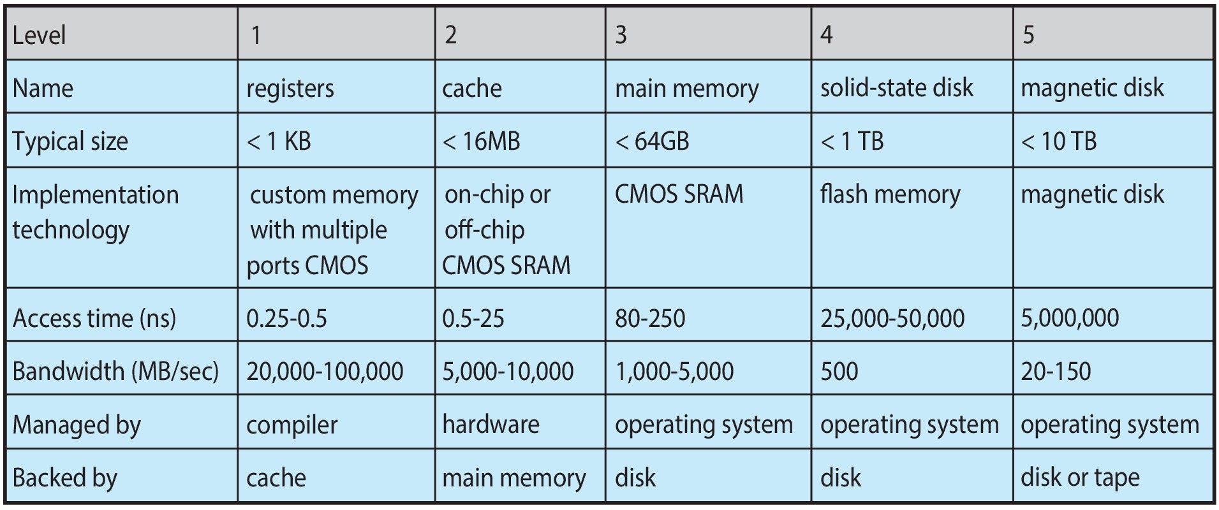
Characteristics of Various Types of Storage
Movement between levels of storage hierarchy can be explicit or implicit
Notes:
The compiler provides the instructions which are used by the registers.
M1 or M2 chips in Mac manage the registers.
Assembly code: Add R1,R2,R3 (Means R1=R2+R3). This is executed the the CPU.
The selection of registers is the job of compiler.
Assembly language example:
Load R3, #M3
Load R2, #M2
Add R1, R2, R3
Mul R4, R1, #5

Slide 41
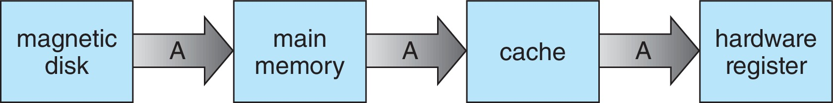
Migration of data “A” from Disk to Register
Multitasking environments must be careful to use most recent value, no matter where it is stored in the storage hierarchy
Multiprocessor environment must provide cache coherency in hardware such that all CPUs have the most recent value in their cache
Distributed environment situation even more complex
Several copies of a datum can exist
Notes:
We need to make sure all the cache has the same data during the execution.

Slide 42
I/O Subsystem
One purpose of OS is to hide peculiarities of hardware devices from the user
I/O subsystem responsible for
Memory management of I/O including buffering (storing data temporarily while it is being transferred), caching (storing parts of data in faster storage for performance), spooling (the overlapping of output of one job with input of other jobs)
General device-driver interface
Drivers for specific hardware devices
Notes:
Spooling (simultaneous peripheral operation on-line.)

Slide 43
Protection and Security
Protection – any mechanism for controlling access of processes or users to resources defined by the OS
Security – defense of the system against internal and external attacks
Huge range, including denial-of-service, worms, viruses, identity theft, theft of service
Systems generally first distinguish among users, to determine who can do what
User identities (user IDs, security IDs) include name and associated number, one per user
User ID then associated with all files, processes of that user to determine access control
Group identifier (group ID) allows set of users to be defined as a group to allow or disallow operations on a file/resource.
Privilege escalation allows user to change to effective ID with more rights
Notes:
denial-of-service attacks (which use all of a system’s resources and so keep legitimate users out of the system)
Protection: which access the resource from one user or program to another user or program.
Security: Whether the OS is protected from external attacks.
Privileges: Sometimes we need to have admin privileges to install some software even in our own system.

Slide 44
Virtualization
Allows operating systems to run applications within other OSes
Vast and growing industry
Emulation used when source CPU type different from target type (i.e. PowerPC to Intel x86)
Generally slowest method
When computer language not compiled to native code – Interpretation
Virtualization – OS natively compiled for CPU, running guest OSes also natively compiled
Consider VMware running WinXP guests, each running applications, all on native WinXP host OS
VMM (virtual machine manager) provides virtualization services
Notes:
An example of virtualization is VMWare.
We will use:
Software: Virtual Box
OS: Ubuntu
Emulation: Software allowed to work on some hardware which it should not.
PowerPC and Inter x86 are architecture.
Interpretation or Emulation: Executing the instructions of one program as input and, convert the instructions into other architecture dynamically. It is slow but important sometimes.

Slide 45
Virtualization (cont.)
Use cases involve laptops and desktops running multiple OSes for exploration or compatibility
Apple laptop running Mac OS X host, Windows as a guest
Developing apps for multiple OSes without having multiple systems
Quality assurance testing applications without having multiple systems
Executing and managing computer environments within data centers
VMM can run natively, in which case they are also the host – within data centers
There is no general-purpose host then (VMware, ESX and Citrix XenServer)

Slide 46
Computing Environments - Virtualization
Notes:
All the processes go through the API(programming interface) to the kernel for execution.

Slide 47
Further Reading
1.8 Distributed Systems
1.9 Kernel Data Structures
1.10 Computing Environments
1.11 Free and Open-Source Operating Systems

